Slide 1



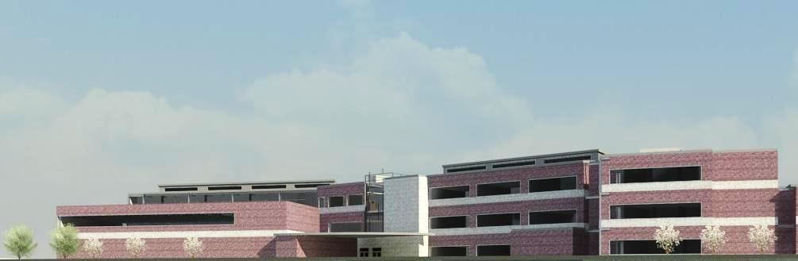



goals BIM schedule site packages renovation results
Presentation 4: Proposal
AEI Student Competition:
Reading School District Elementary School
Construction
Jenna Dumke
Jeff Sopinski
Structural
Patrick Zuza
Emily Wychock
Lighting/Electrical
Abby Kun
Amanda Small
Mechanical
Kristiana McMunn
Mike Hoffacker

Slide 2
goals BIM schedule site packages renovation results
Results
Purpose & Team Goals
Results
Team Goal: To create an innovative, high-performance environment in a way that stimulates involvement in both education & the community.
Higher Attendance
Improved Teacher Satisfaction
Higher Test Scores
Functionality
Efficiency
Community
LEED Certification
Safer Environment
Lower Operational
Costs
Median Construction Cost
Appeal

Slide 3
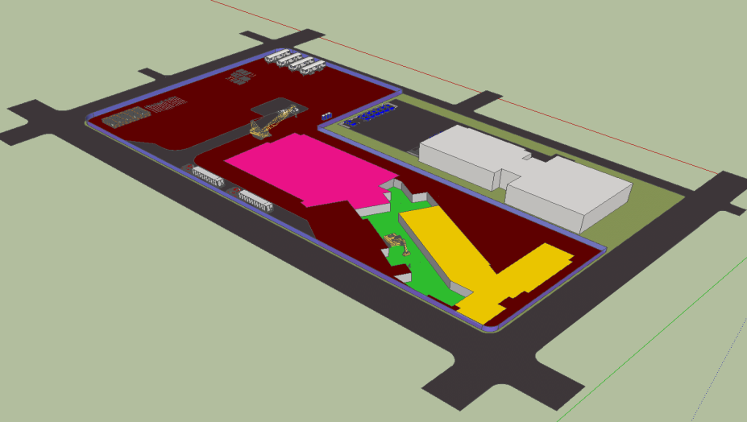
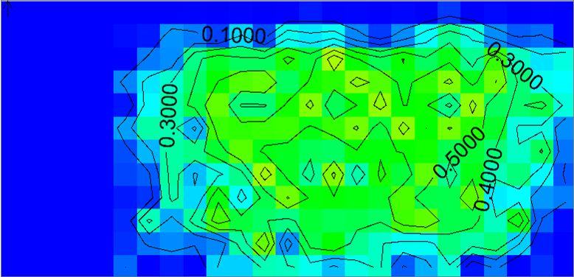
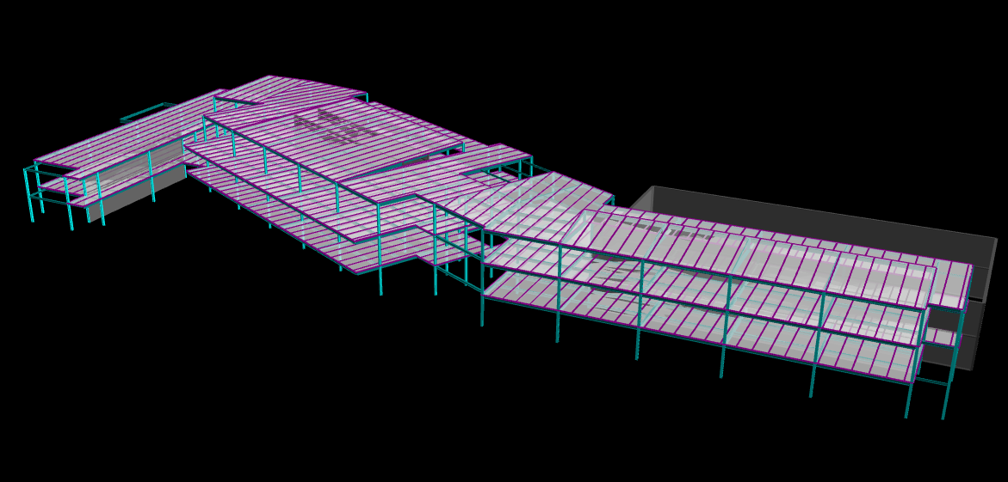
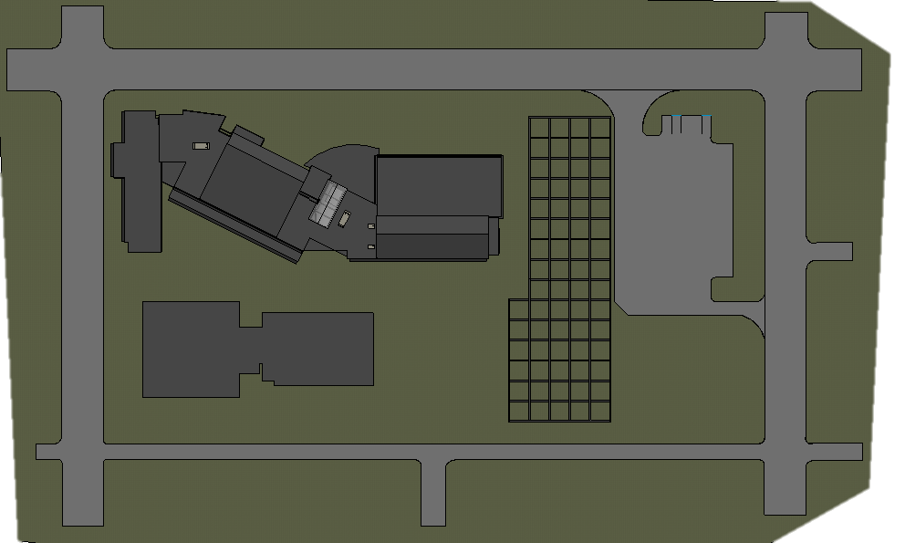
goals BIM schedule site packages renovation results
BIM Execution Plan
BIM Uses | Applicable Software
Scheduling | P6
Clash Detection | Navisworks
Estimating | RSMeans CostWorks
Virtual Mockups | SketchUp
BIM Uses | Applicable Software
Lighting Calculations | AGi32
Daylighting & Electrical Integration | Daysim
Wiring, Circuiting, Systems Coordination | Revit
Rendering | 3ds Max
BIM Uses | Applicable Software
Systems Coordination | Revit
Gravity System | RAM
Lateral System | ETABS
Modeling Space Frames | AutoCAD
Masonry Design | RAM Element
BIM Uses | Applicable Software
Scheduling | Trace
Clash Detection | Revit
4D Modeling | Excel

Slide 4
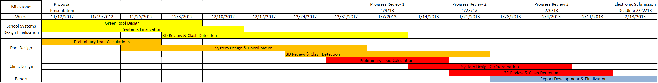
goals BIM schedule site packages renovation results
Production Schedule
Proposal Presentation
Winter
Break
Progress Review 1
Progress Review 2
Progress Review 3

Slide 5
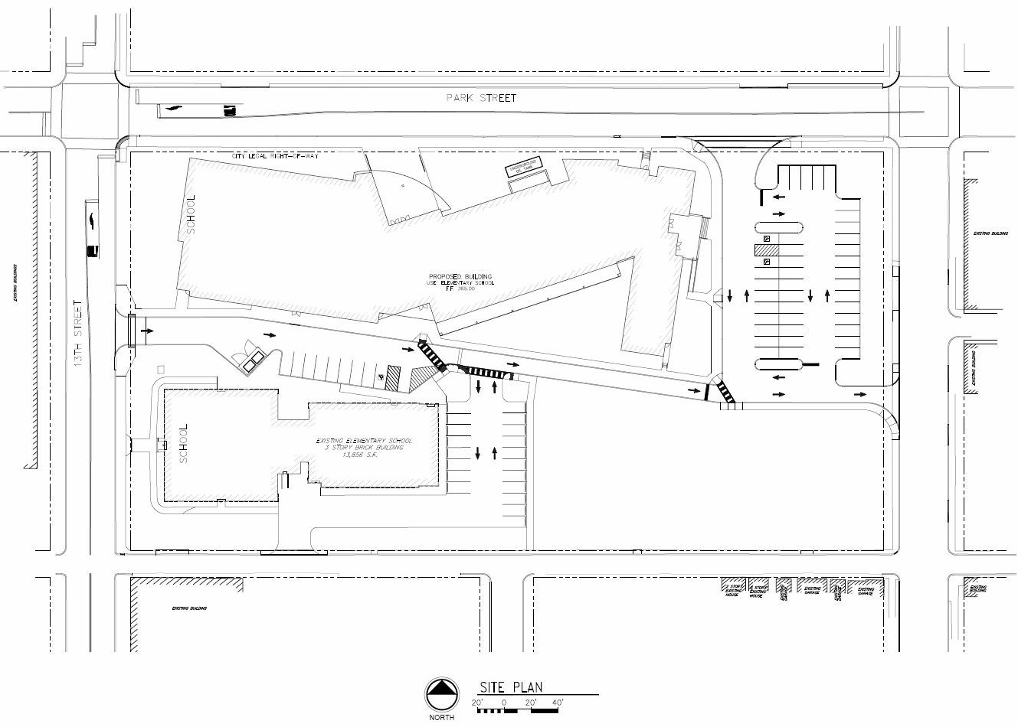
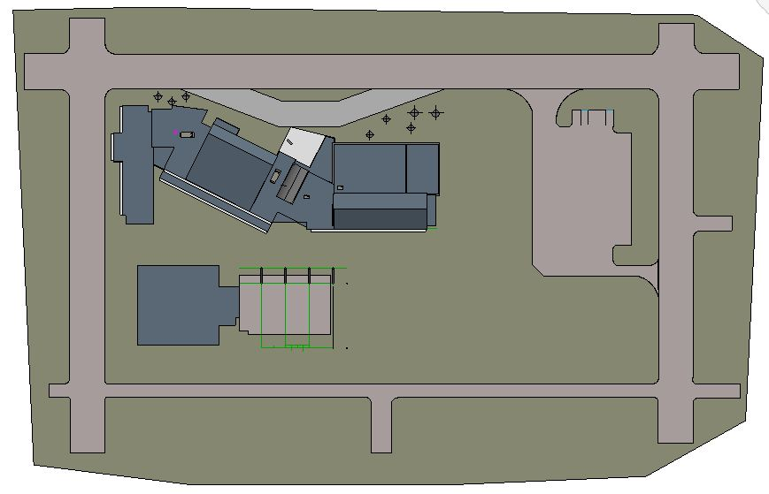
goals BIM schedule site packages renovation results
Master Plan
Proposed Plan
Design Considerations
Restricted Site
Renovation
Traffic Flow
Parking Accessibility
Geothermal Boring Location
Constructability
Site Lighting and Light Trespass
Our Plan

Slide 6
goals BIM schedule site packages renovation results
Enclosure
create a functional barrier from exterior elements while maintaining aesthetic appeal & interior comfort.
Notes:
Design Considerations:
-

Slide 7
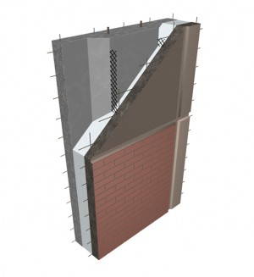
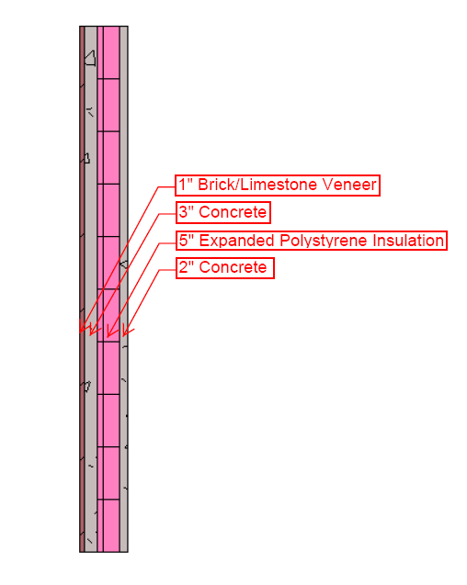
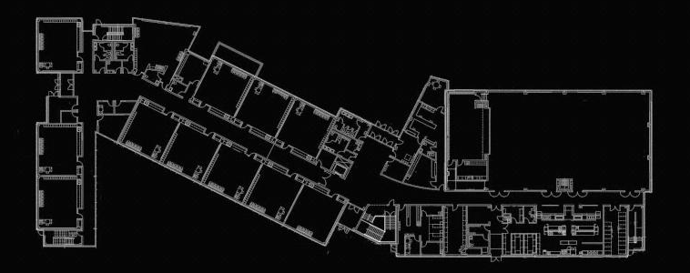
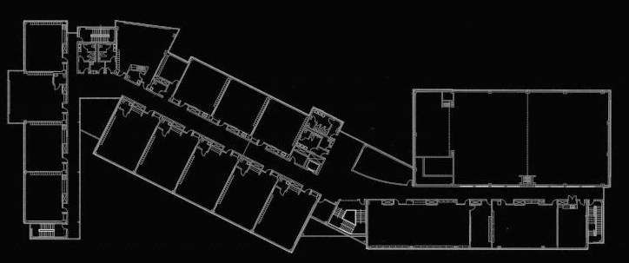
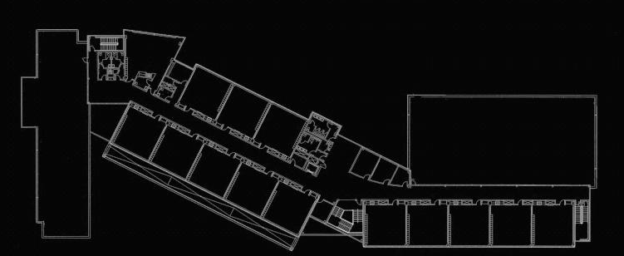
goals BIM schedule site packages renovation results
Enclosure
WALL DESIGN GOALS
To achieve our target U-value, while minimizing costs and optimizing energy efficiency and constructability.
WALL DESIGN CRITERIA
ASHRAE 90.1 Required U-value = 0.069
ASHRAE 50% energy savings recommended U-value = 0.037
RESULTS
OUR WALL: U-Value = 0.383
CONSTRUCTABILITY
Two concrete wythes separated by insulation
Lightweight = larger panel sizes, smaller structural frame
Less crane picks, faster installation
Local fabricator within 20 miles = fast deliveries, low delivery costs
$27 per SF
$1,102,300.00
create a functional barrier from exterior elements while maintaining aesthetic appeal & interior comfort.
Notes:
Design Considerations:
-

Slide 8
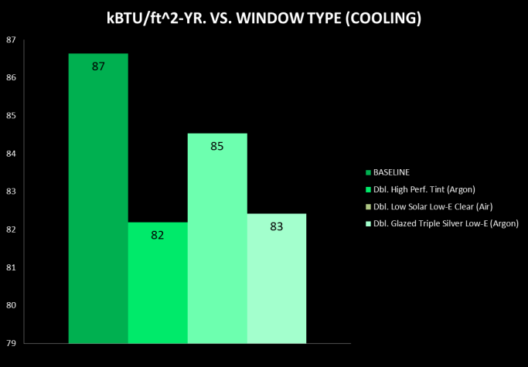
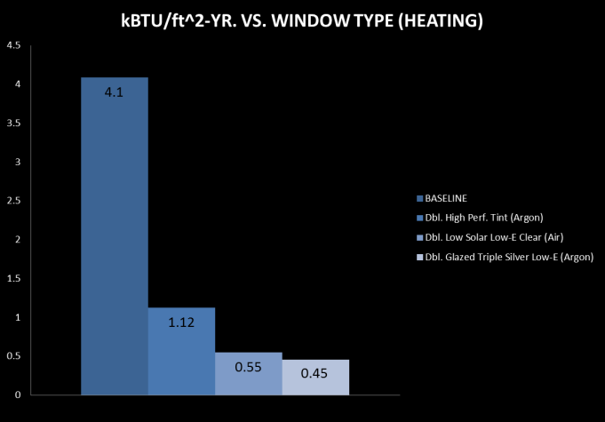
goals BIM schedule site packages renovation results
Enclosure
RESULTS
Our Window: U-Value = 0.54, SHGC = 0.4, VT = 0.6
Window to Wall Ratio = 29.5%
FENESTRATION DESIGN GOALS
To maximize the amount of natural daylight in the classroom spaces, while minimizing the cost of construction and optimizing energy savings.
FENESTRATION DESIGN CRITERIA
ASHRAE 90.1 Requirements: U-Value = 0.55, SHGC = 0.4,
ASHRAE 50% Energy savings recommendation: U-value = 0.45, SHGC = 0.5, VT = 0.63
Window to Wall Ratio < 40%
create a functional barrier from exterior elements while maintaining aesthetic appeal & interior comfort.

Slide 9
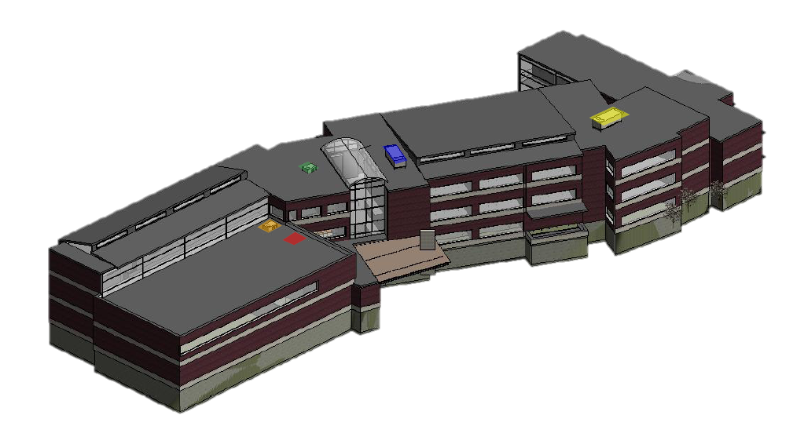
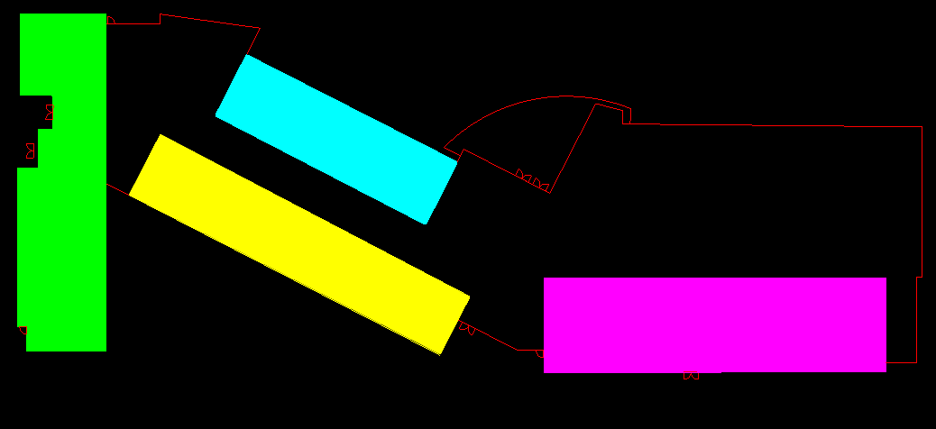
goals BIM schedule site packages renovation results
Enclosure
Clerestory
Light Shelf and Clerestory Layout
4
create a functional barrier from exterior elements while maintaining aesthetic appeal & interior comfort.
1
2
3
3
5
Curtain Walls
ZONE 1
ZONE 2
ZONE 3
Lightshelf
Clerestory & Lightshelf
ZONE 4
ZONE 5

Slide 10
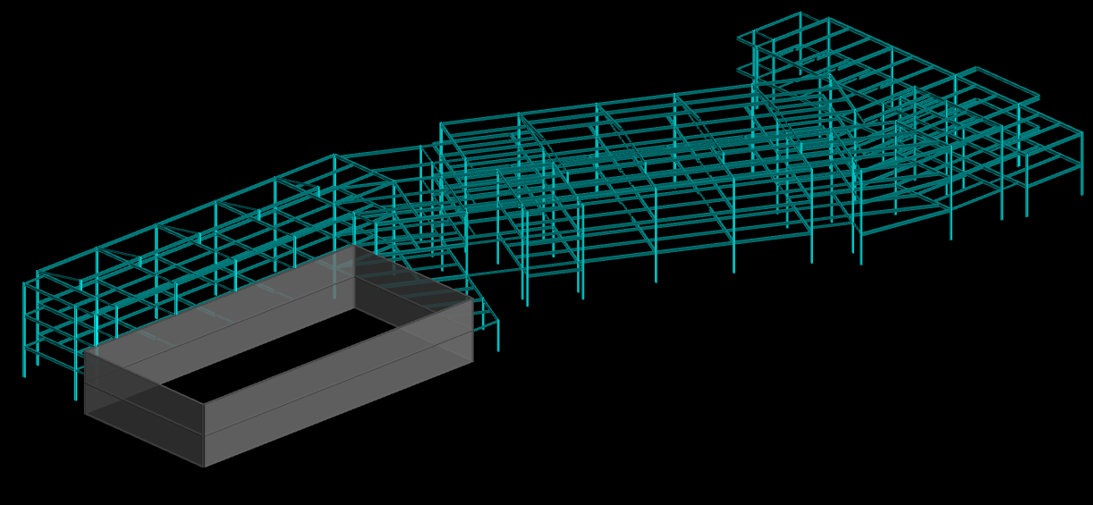
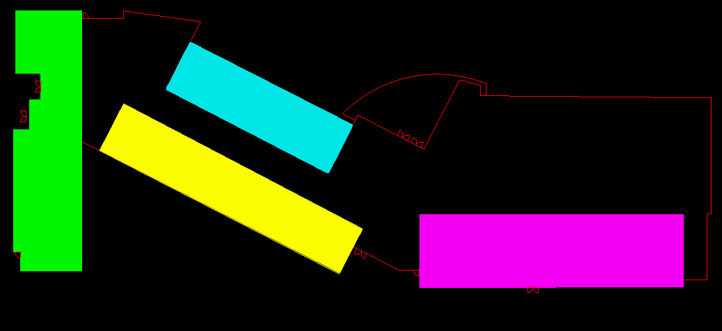
goals BIM schedule site packages renovation results
Enclosure
Clerestory
Light Shelf and Clerestory Layout
4
create a functional barrier from exterior elements while maintaining aesthetic appeal & interior comfort.
1
2
3
3
5
Panels attached to steel frame
Bay spacing to accommodate desired window area
Curtain Walls
Lightshelf
Clerestory & Lightshelf

Slide 11
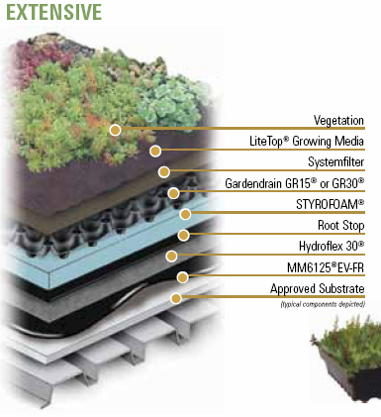
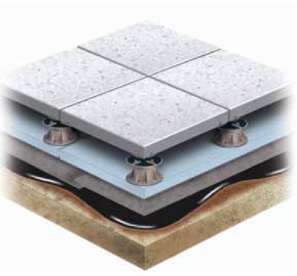
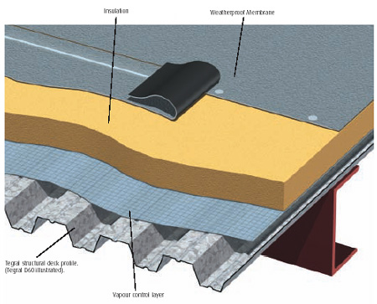
goals BIM schedule site packages renovation results
Enclosure
ROOF DESIGN GOALS
To achieve our target U-value, while minimizing additional structure costs and optimizing energy efficiency and constructability.
ROOF DESIGN CRITERIA
ASHRAE 90.1 U-value = 0.048 with insulation entirely above deck, c.i.
ASHRAE 50% energy savings recommended U-value = 0.0333 with c.i
Green Roof Analysis
CONSTRUCTABILITY
Lightweight system
Minimal maintenance
Retains rainwater during droughts
Open joint assembly
Access to substrate
Green Roof Depth: 4”
Compared to a dark roof :
Electrical: 3179.2 kWh
Total Energy Cost Savings: $407.40
Compared to a white roof :
Electrical: 1707.7 kWh
Total Energy Cost Savings: $288.79
RESULTS
Our Roof: U-value = 0.0333

Slide 12
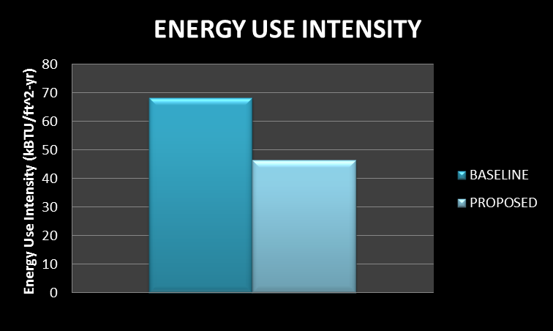
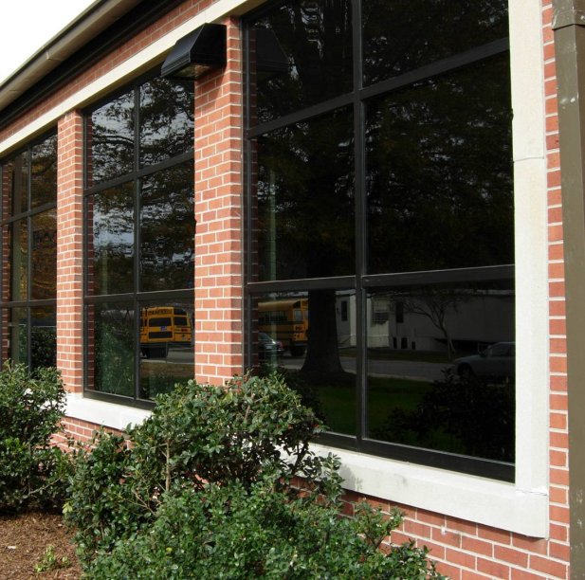
goals BIM schedule site packages renovation results
Enclosure
Results
ENTIRE ENCLOSURE ENERGY SAVINGS
WALL: U-Value = 0.383
ROOF: U-value = 0.033
WINDOW: U-Value = 0.540, SHGC = 0.4, VT = 0.6
create a functional barrier from exterior elements while maintaining aesthetic appeal & interior comfort.
Reduced energy use intensity by 22 kBTU/ft^2-yr
(represents all selected enclosure materials with a ground source heat pump system)

Slide 13
goals BIM schedule site packages renovation results
Atrium
create an attractive & secure entrance to welcome students, faculty, and guests.
Notes:
Design Considerations
-optimum daylight while keeping mechanical loads reasonable
-architecture
-access to spaces

Slide 14
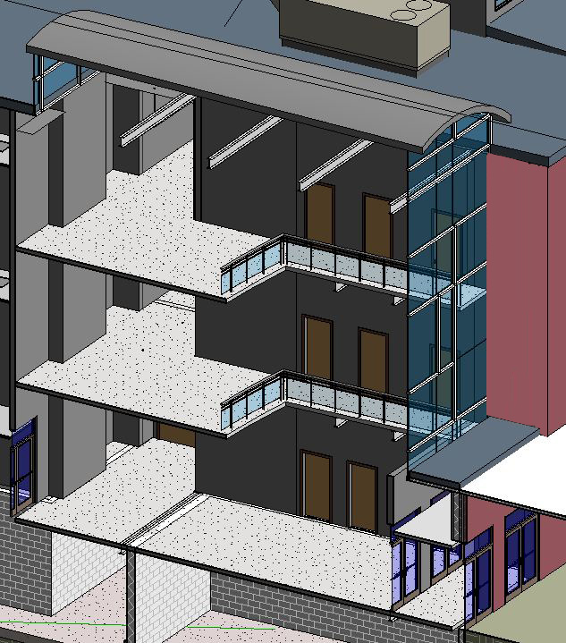
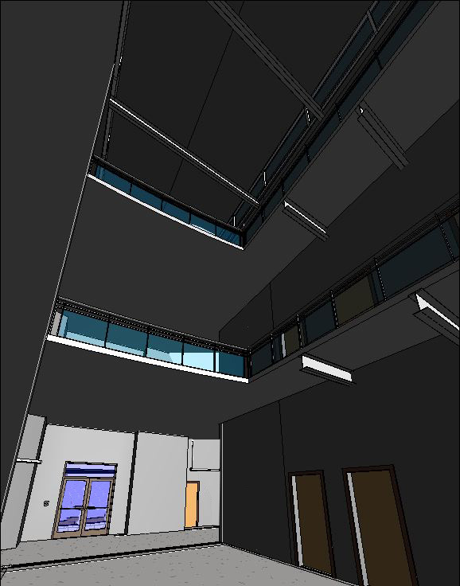
goals BIM schedule site packages renovation results
Atrium
DESIGN CONSIDERATIONS
Mechanical loads
  Glass – high solar loads
  Air must be supplied for all three floors
Glare
Diffuse Daylighting
Light Levels
Safety
create an attractive & secure entrance to welcome students, faculty, and guests.

Slide 15
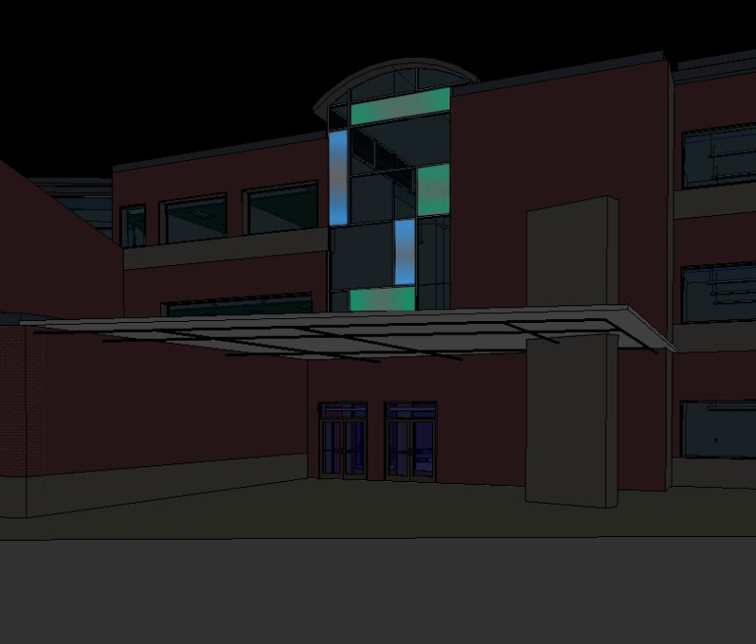
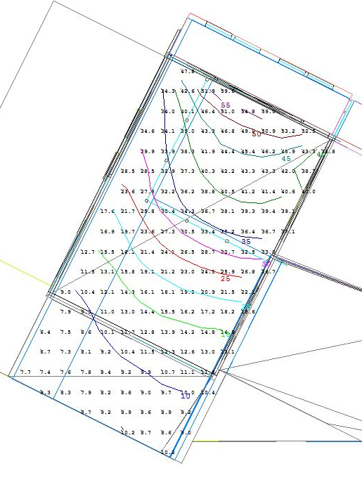
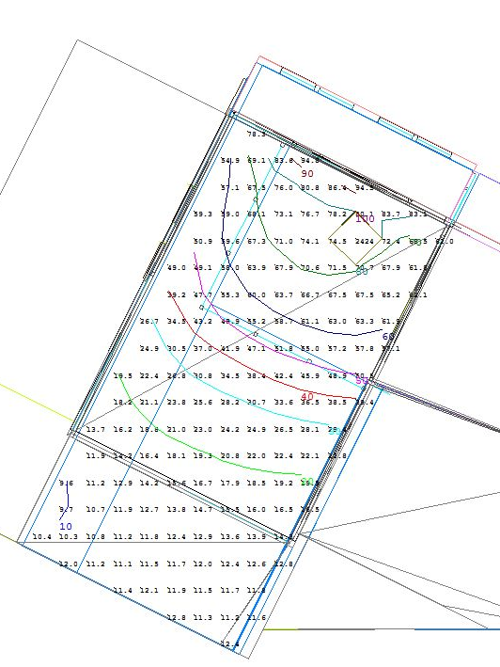
goals BIM schedule site packages renovation results
Atrium
December 21st @ Noon
June 21st @ Noon
create an attractive & secure entrance to welcome students, faculty, and guests.
Average Illuminance: 25 fc
Average Illuminance: 53 fc

Slide 16
goals BIM schedule site packages renovation results
Classrooms
create a stimulating & comfortable learning environment.
Notes:
Design considerations:
-controlled natural day lighting
-indoor air quality and thermal comfort
-adaptable to student needs
-energy savings

Slide 17
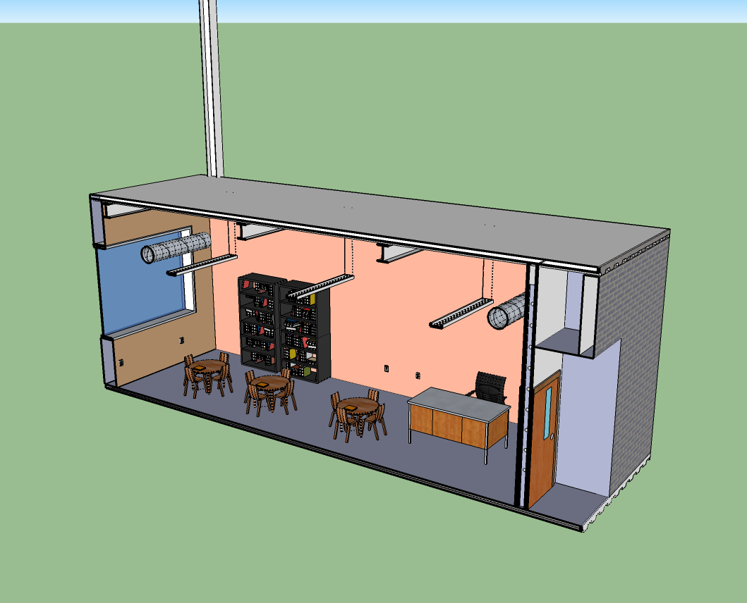
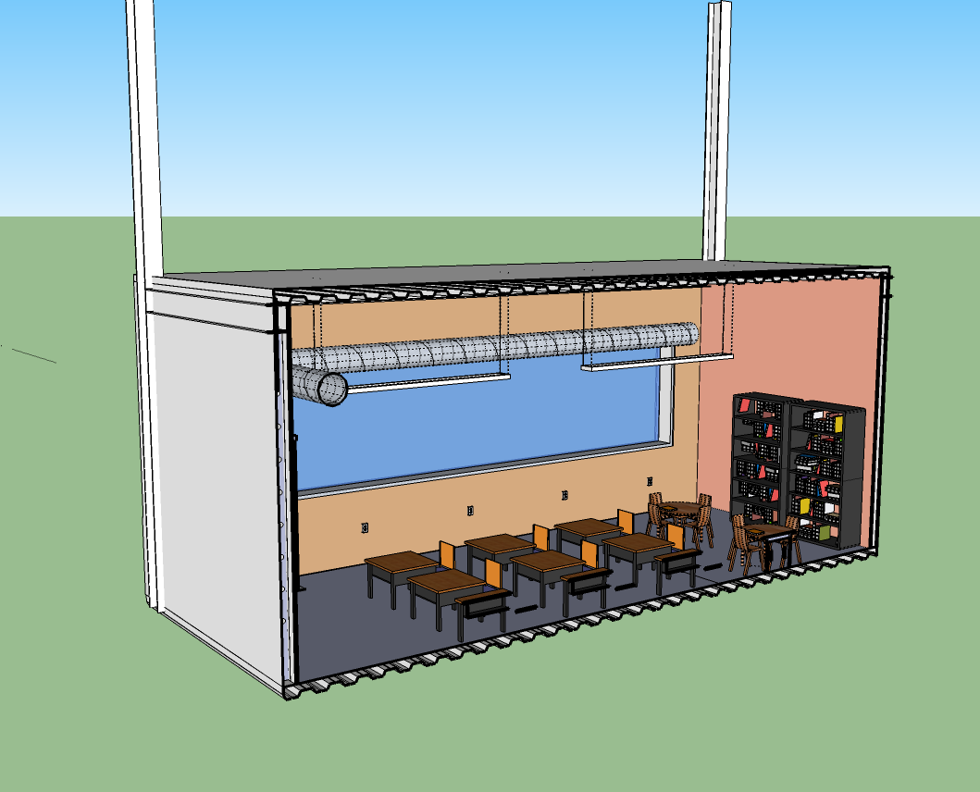
goals BIM schedule site packages renovation results
Classrooms
create a stimulating & comfortable learning environment.
Notes:
Design considerations:
-controlled natural day lighting
-indoor air quality and thermal comfort
-adaptable to student needs
-energy savings

Slide 18
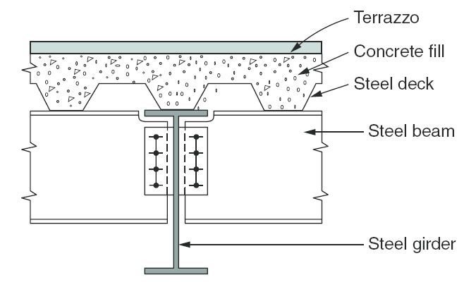
goals BIM schedule site packages renovation results
Classrooms
Cork board
4.5”
create a stimulating & comfortable learning environment.
Typical bay 28 x 30
Limited beam depths
Composite metal deck
W12x40
12”
W14x68
2’ 7.5”
plenum
SUPPLY
RETURN
Notes:
Design considerations:
-controlled natural day lighting
-indoor air quality and thermal comfort
-adaptable to student needs
-energy savings

Slide 19
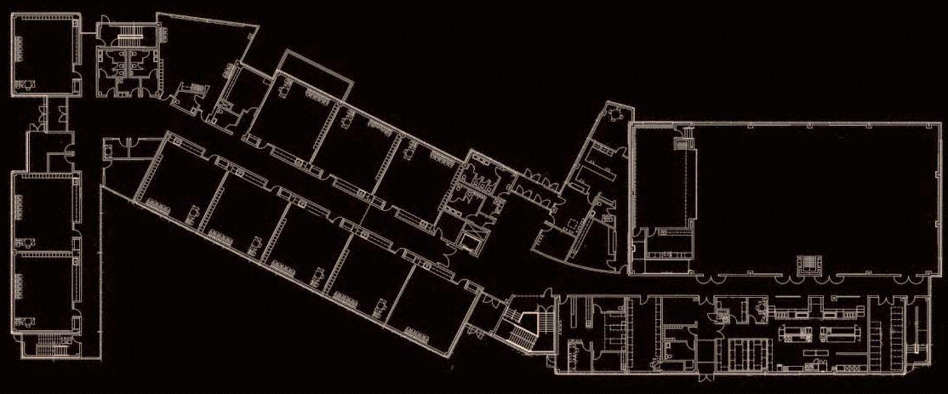
goals BIM schedule site packages renovation results
Classrooms
Cork board
4.5”
create a stimulating & comfortable learning environment.
W12x40
12”
W14x68
2’ 7.5”
plenum
Masonry Shear Wall
Braced Frame
SUPPLY
RETURN
Notes:
Design considerations:
-controlled natural day lighting
-indoor air quality and thermal comfort
-adaptable to student needs
-energy savings

Slide 20
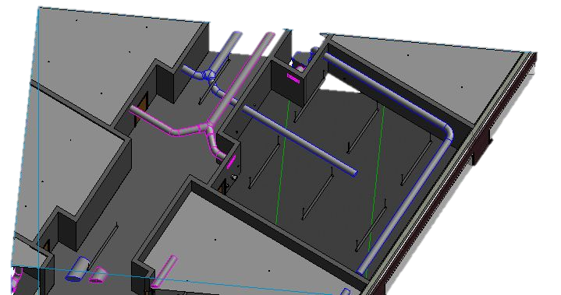
goals BIM schedule site packages renovation results
Classrooms
Cork board
4.5”
create a stimulating & comfortable learning environment.
W12x40
12”
W14x68
2’ 7.5”
plenum
SUPPLY
RETURN
Supply
Return
Notes:
Design considerations:
-controlled natural day lighting
-indoor air quality and thermal comfort
-adaptable to student needs
-energy savings

Slide 21


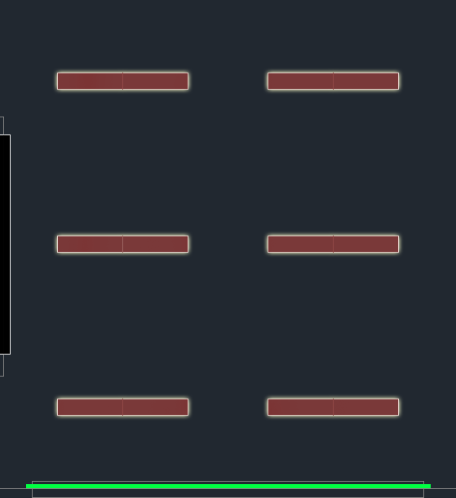
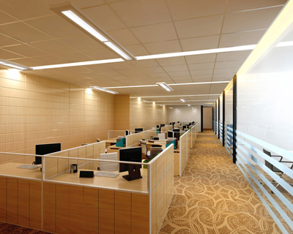
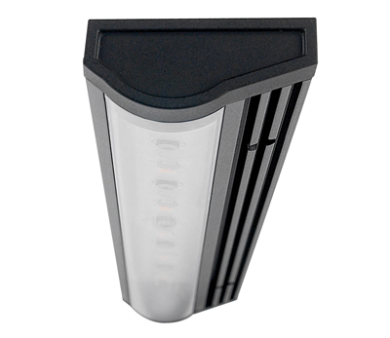
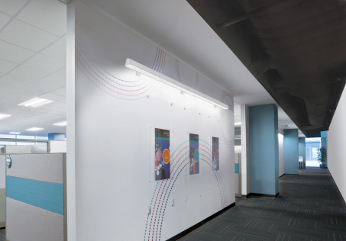
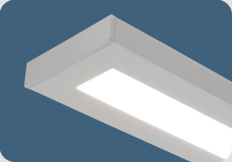
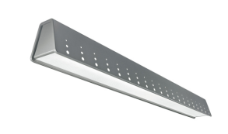
goals BIM schedule site packages renovation results
Classrooms
Test Mode (Full Output)
A/V Mode
S_{D}S₃
S_{D}S₃
S_{D}S₃
create a stimulating & comfortable learning environment.
SC, S₃
SC, S₃
SC, S₃
50% Light Output with Board Light
Company | Fixture Series | Mounting | Lamp
Pinnacle | Linero 8 – 4’ & 8’ | Suspended | T8
Ledalite | Jump – 8’ | Wall | 8’ LED
Ligholier | LED Micro Undercabinet | Surface | 10W/LF LED
Total Classroom Energy Savings per Year:
21,000 kWh

Slide 22

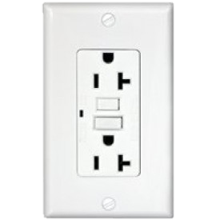
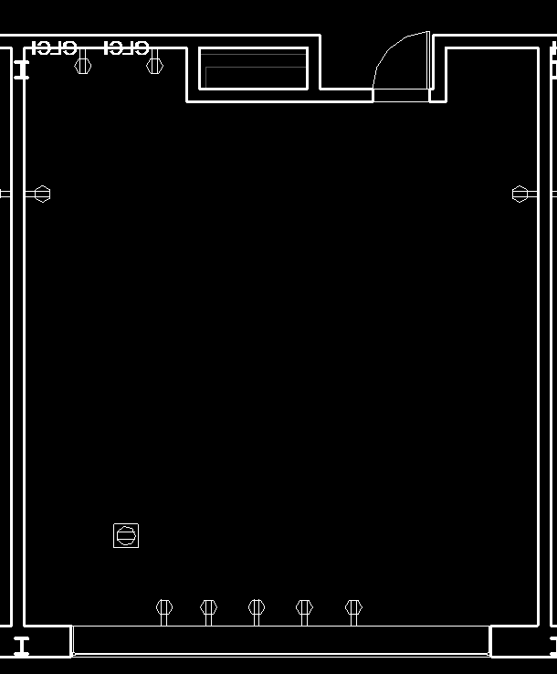
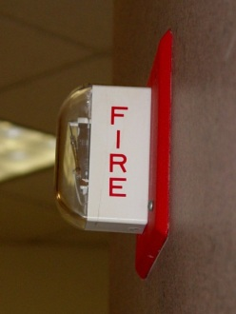

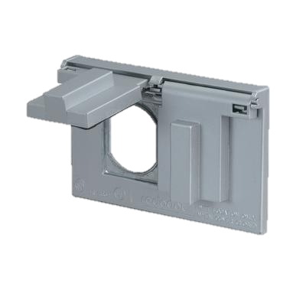

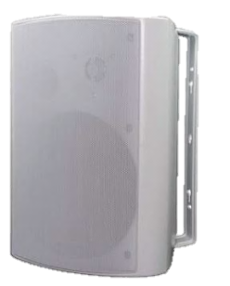
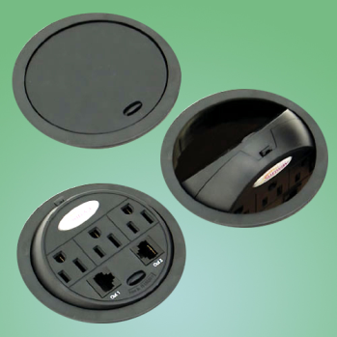
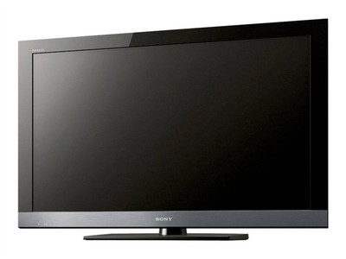
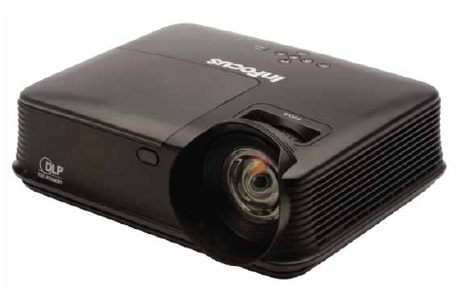
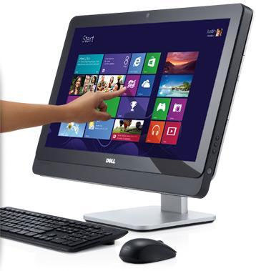

goals BIM schedule site packages renovation results
Classrooms
Equipment Type | Manufacturer | Specific Details
Television | Sony | Wall mounted, data supply for basic television and morning news
Projector | InFocus | Classroom grade projector, ceiling mounted, interactive screen functions
Computers | Dell | High performance and functionality, touchscreen interaction
LIGHTOLIER
EX 2 Edge-Lit Exit Series
Double Face, Self-Powered
** Alternate products are also acceptable if required specifications can be met **
All images from google.com

Slide 23
goals BIM schedule site packages renovation results
Administration
create a productive & inviting work environment
Notes:
Design Considerations
-controlled daylighting to increase productivity
-thermal comfort & indoor air quality
-separate zoning system for grownups

Slide 24
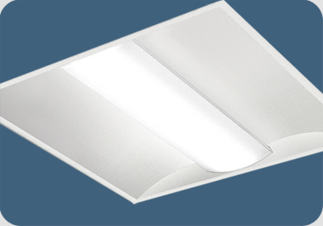




goals BIM schedule site packages renovation results
Administration
1.
2.
4.
3.
create a productive & inviting work environment
Company | Fixture Series | Mounting | Lamp
1. Pinnacle | Adeo 2’x2’, 2’x4’ | Recessed | T8
2. Lightolier | Calculite 6”x6” Square DL | Recessed | 27W LED
3. Lightolier | Wal-Master Wall Washer | Recessed | T8
4. AXIS | Beam 4 – Perimeter System | Recessed | T8
DESIGN CONSIDERATIONS
Mechanical equipment noise
Security system
Structural grid irregularity
2’x2’ Tile Ceiling – Dropped at 8’

Slide 25


goals BIM schedule site packages renovation results
Administration
create a productive & inviting work environment
DESIGN CONSIDERATIONS
Mechanical equipment noise
Security system
Structural grid irregularity

Slide 26

goals BIM schedule site packages renovation results
Administration
Visiplex System Functions
Classroom and Building Speakers
Intercom system at entry
Synchronized Clocks
Fire Alarm Announcement Integrated
All Controlled from main admin office, as well as from an intranet log in from home computers
DESIGN CONSIDERATIONS
Mechanical equipment noise
Security system
Structural grid irregularity
Visiplex.com

Slide 27
goals BIM schedule site packages renovation results
Corridor
create a space which accommodates traffic flow and major building system components

Slide 28

goals BIM schedule site packages renovation results
Corridor
DESIGN CONSIDERATIONS
Plenum space
Acoustics
create a space which accommodates traffic flow and major building system components

Slide 29

goals BIM schedule site packages renovation results
Corridor
Design Criteria from IES Lighting Handbook
Age Range | 25-65
Average Illuminance | 5 fc
Avg:Min Ratio | 2:1
create a space which accommodates traffic flow and major building system components
Pinnacle
Linero 8 – 8ft length
Lighting Power Density (Based on Standard 90.1)
ASHRAE 90.1 | 0.66 W/SF
Actual LPD | 0.25 W/SF
Exposed ceiling
Fixtures
  8ft AFF
  Spaced 30ft on center
Acoustic paneling
  Hung from ceiling and mounted high on walls

Slide 30
goals BIM schedule site packages renovation results
Multipurpose Room
create a flexible space for the school and community.
Notes:
Design Considerations:
-Ceiling space coordination between trusses, skylights, ducts, and lights
-changing occupancy
-

Slide 31


goals BIM schedule site packages renovation results
Multipurpose Room
create a flexible space for the school and community.
32”Steel Trusses
10”Reinforced Masonry Walls

Slide 32
goals BIM schedule site packages renovation results
Multipurpose Room
Fixtures
  15 (6) 54W T5HO
  Philips Day-Brite Fluorescent Gym Luminaire
create a flexible space for the school and community.
Design Criteria from IES Lighting Handbook (for Class 3 Sports Lighting)
Age Range | 25-65
Average Illuminance | 50 fc
Avg:Min Ratio | 3:1
Lighting Power Density (Based on Standard 90.1)
ASHRAE 90.1 | 1.20 W/SF
Actual LPD | 0.89 W/SF

Slide 33


goals BIM schedule site packages renovation results
Multipurpose Room
Useful Daylight Illuminance
(500 lux and greater)
Passive Daylighting System
paired with
So-Dark Motorized Shade Screen
By Daylighting Systems, Inc.
Stage
Without Skylights
create a flexible space for the school and community.
Stage
With Skylights
4’x4’ with 2.5’ light well
Energy Savings per Year = 1,791 kWh

Slide 34
goals BIM schedule site packages renovation results
Pool & Clinic Renovation
create a recreational building to encourage healthy living and community involvement
Notes:
Due to site constraints we chose to renovate the existing elementary school, demolish half of it and renovate the rest for the clinic. We did this to keep maximum outdoor space
Design Considerations that we will consider:
-extreme thermal loads
-create a badass place that people in the community want to go to and are proud of
-large roof spans
-specific indoor pool requirements

Slide 35

goals BIM schedule site packages renovation results
Pool & Clinic Renovation
CONSTRUCTABILITY
Scheduling & Phasing
Site Logistics
Budget
create a recreational building to encourage healthy living and community involvement
DESIGN CONSIDERATIONS
Humidity
Energy Savings
Large roof span
Lighting fixtures

Slide 36


goals BIM schedule site packages renovation results
Pool & Clinic Renovation
create a recreational building to encourage healthy living and community involvement

Slide 37



goals BIM schedule site packages renovation results
Pool & Clinic Renovation
create a recreational building to encourage healthy living and community involvement
Northwest corner

Slide 38




goals BIM schedule site packages renovation results
Pool & Clinic Renovation
Fixture Considerations
  High Bay Fixtures
  Water tight fixtures
  Complete lifecycle cost analysis
create a recreational building to encourage healthy living and community involvement
Show new floor plan
Design Criteria from IES Lighting Handbook (for Class 3 Sports Lighting)
Age Range | 25-65
Average Deck Illuminance | 100 fc
Average Water Illuminance | 300 fc
Avg:Min Ratio | 3:1
Lighting Power Density (Based on Standard 90.1)
ASHRAE 90.1 | 1.20 W/SF

Slide 39
goals BIM schedule site packages renovation results
LEED Certification
Currently 51 points for LEED Silver
Lighting Power Density
Interior: about 46,000 W/SF
44.8% below ASHRAE Standard 90.1 Requirements
*Does not include specialty lighting spaces (Library & Atrium)
Team Goal: To create an innovative, high-performance environment in a way that stimulates involvement in both education & the community.
Operability
Decreased maintenance of green roof
Less maintenance of geothermal mechanical system
Floor to Floor Height Reduction Savings
Façade: 6775 square feet, $182,000
Structural Steel: 762 LF, 38100 lbs, $50,000
Air Volume: 660,000 CF
Energy Use Intensity savings
Reduced the building energy use intensity by 22 kBTU/ft^2-yr through enclosure design and system selection

Slide 40



goals BIM schedule site packages renovation results
Building Systems
Lighting/Electrical Systems
Structural Systems
Public Spaces all on Building Management System
Emergency fixtures will also serve as normal power and default to emergency when necessary.
277/480V Lighting Panels, 120/208V Electrical Panels
Interior building transformer and generator
On site High Voltage transformer; secondary
Overhead power lines supply building
Structural steel frame, typical classroom 28x30
W10 and W12 columns spliced at 3rd floor
W14 girders and W12 beams, W8 girders in corridors
Braced frames and reinforced masonry shear walls
Composite metal deck
Mechanical Systems
Ground Source Heat Pump System
5 Dedicated Outdoor Air Units serving 5 zones
Outdoor air units take the majority of the sensible and latent loads
Ventilation and Terminal Unit split system
Heat Pumps range in size from 3/4 – 3 tons
Construction
Multiple Prime with Construction Management Agency
Proposed CM @ Risk w/ Design Assist Subs
Construction Budget: $18,00,000
15 Month Schedule
Rammed Aggregate Piers

Slide 41
goals BIM schedule site packages renovation results
Images taken from:
axislighting.com
daylighting.com
lightolier.com
ledalite.com
pinnacle-ltg.com
Lithonia.com
acoustimac.com

